Slide 1

Intelligent Pedestrian Sign
Student: Steven(邱國哲)、Jamie(羅梓軒)

Slide 2
Outline
1.Abstract
2.why do we need this technology
3. Workflow
4. detect object
5. Traffic light
6.Demo
7. Conclusion

Slide 3
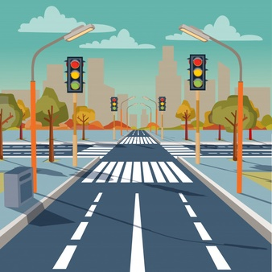
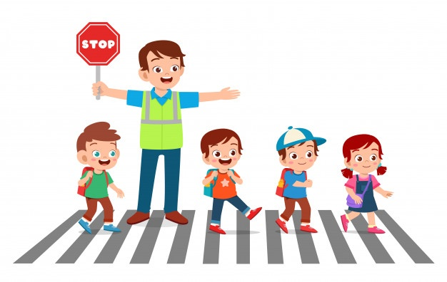
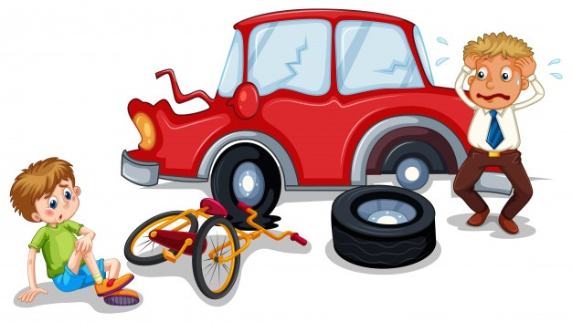
Abstract
Nowadays, there are lots of pedestrians dead in car accident
Ignore the remaining seconds of traffic light
Blind spots of car
In order to decrease the dead rate of crossing people, we invent the system called “Intelligent Pedestrian Sign”

Slide 4
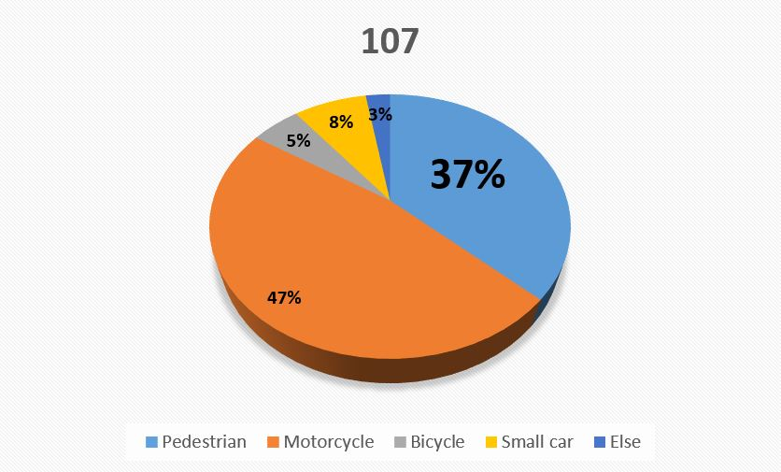
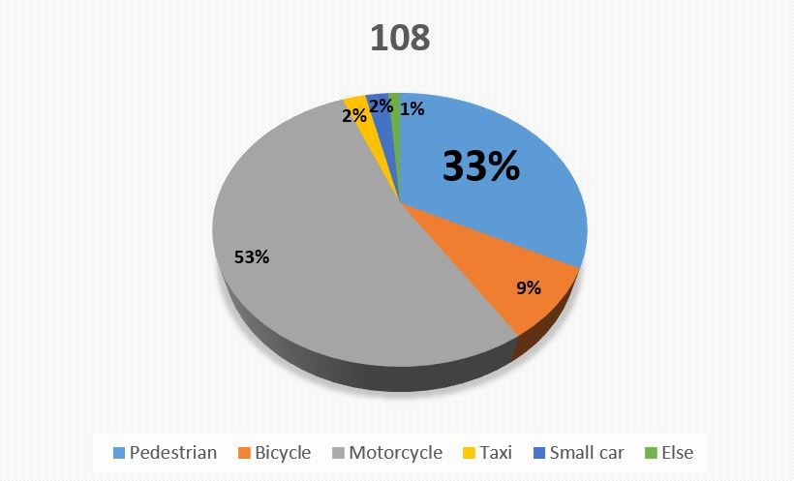
why do we need this technology
Notes:
這些資料來自於107,108台北市政府統計，在所有類別中,<行人>為交通事故死傷數中排名第二,僅次於<機車>。其中又以高年齡層為主。

Slide 5
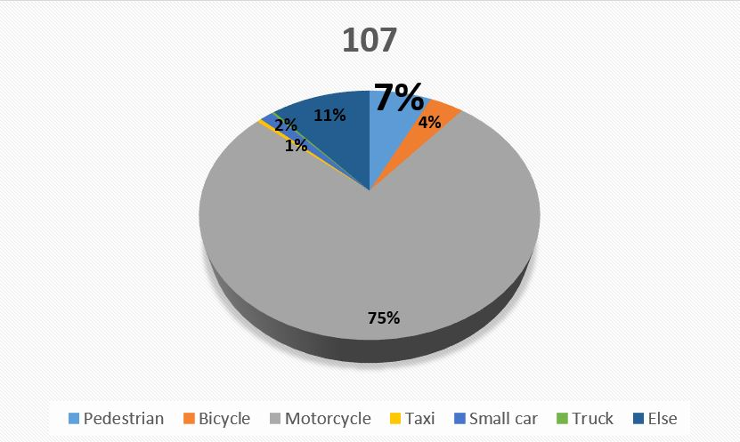
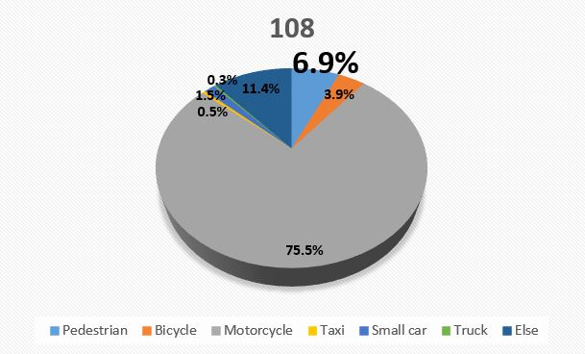
why do we need this technology

Slide 6
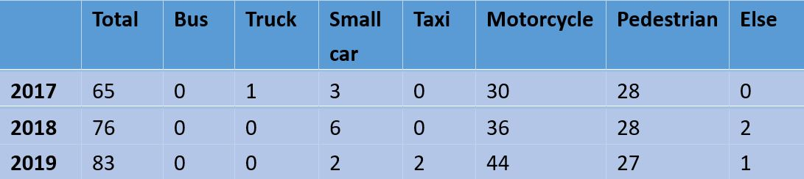
why do we need this technology
Death toll
Notes:
這些資料來自於107,108台北市政府統計，在所有類別中,<行人>為交通事故死傷數中排名第二,僅次於<機車>。其中又以高年齡層為主。

Slide 7
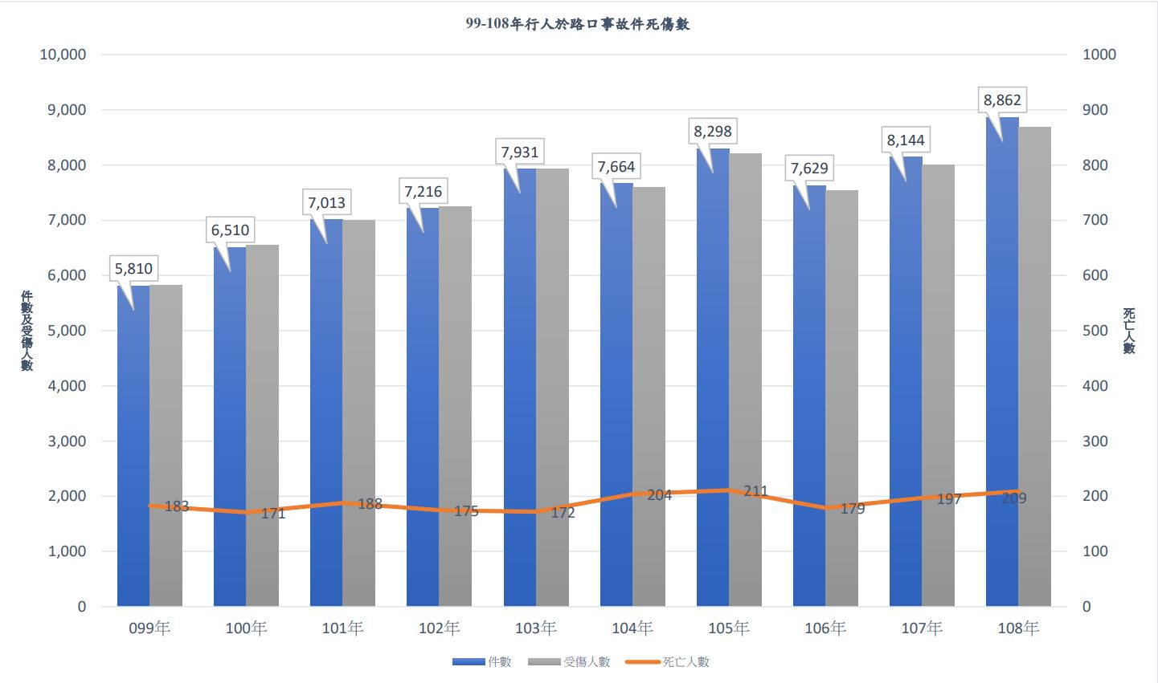
why do we need this technology
Dead
Number
Injured
Dead
Notes:
這些資料來自於107,108台北市政府統計，在所有類別中,<行人>為交通事故死傷數中排名第二,僅次於<機車>。其中又以高年齡層為主。

Slide 8
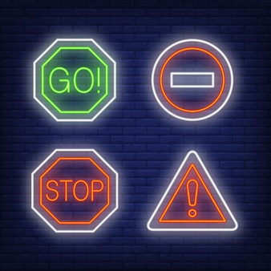
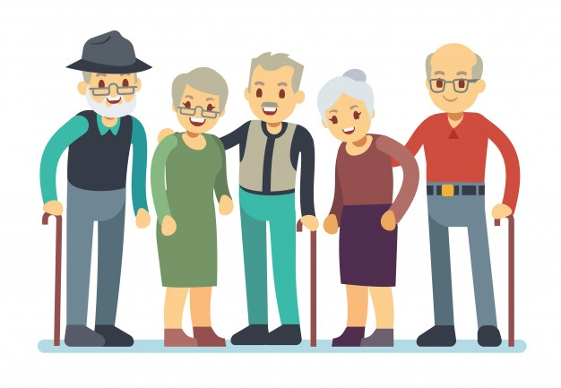
Workflow
Detect pedestrians who want to cross the road
Predict the number of seconds to cross the road
If someone has difficulty moving, increase the number of seconds of the signal

Slide 9
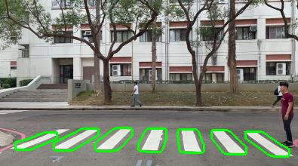
Detect Zebra crossing
Detect zebra crossing as a target area

Slide 10
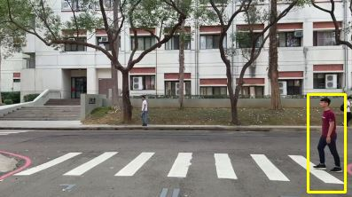
Detect pedestrians
Detect pedestrians in the target area

Slide 11
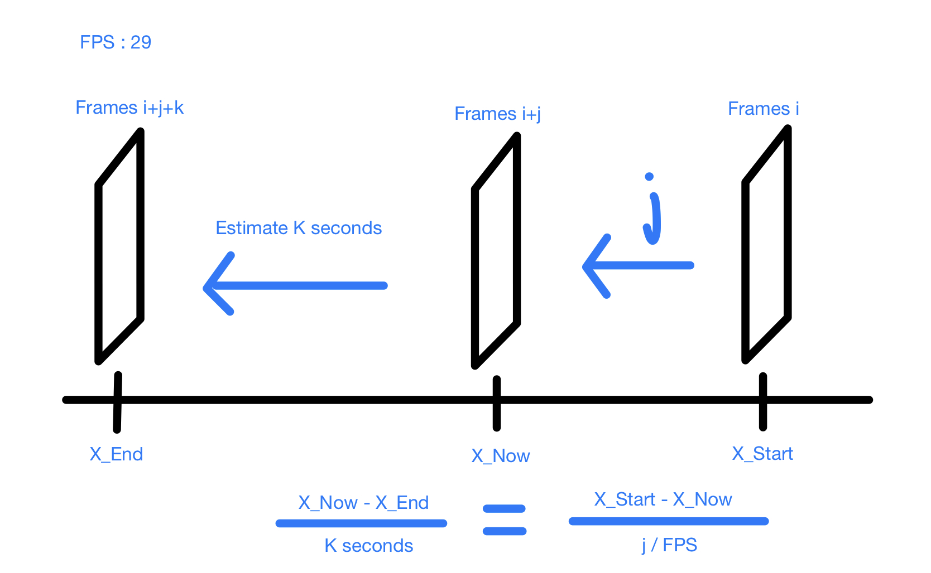
Estimate
Forecast seconds

Slide 12
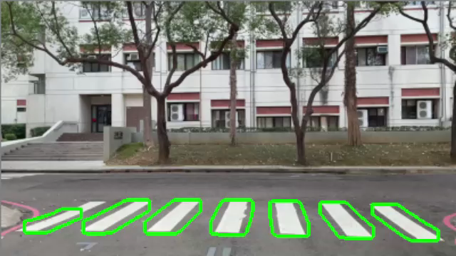
Demo

Slide 13
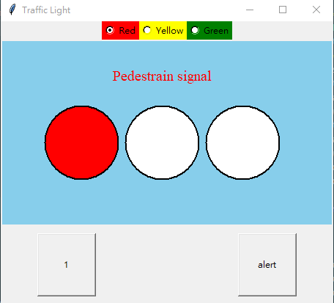
GUI-Traffic light
Propose: Connect the detecting Pedestrian cross the crosswalk and dynamically change the green light seconds if it needs

Slide 14
GUI-Functions
Button:
Red yellow green
when we click it, it will reset the time we have already set
Alert
when there is a emergency case, add more seconds to the green light
Clock
Countdown the time

Slide 15
Demo Films
Normal:
Red light=2s
Green light=8s
Yellow light=1s

Slide 16
Demo Films
Button: Red yellow green
Can reset the light seconds

Slide 17
Demo Films
Button: Alert
Can optionally increase the
Green light seconds

Slide 18

Demo

Slide 19
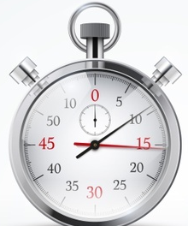
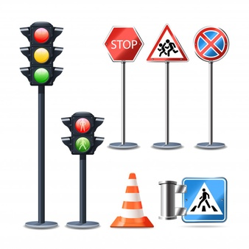
Conclusion
At present, many road detections are focused on smooth traffic based on cars, but the time for pedestrians to cross the road is not concerned, so that it may cause people’s death rate to rise.
Increasing the number of seconds to allow pedestrians to pass can effetely reduce the cases of accidents.

Slide 20
Thanks

